Slide 1

Theory of Machines Continue Degrees of freedom
Dr.Assist. Prof. Dr. Parvaneh Esmaili

Slide 2
Degree-of-freedom (DoF)
Degree of freedom (also called the mobility M) of a system can be defined as:
the number of inputs which need to be provided in order to create a predictable output;
also:
the number of independent coordinates required to define its position.

Slide 3
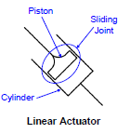
Input = Source of motion
The device that introduces/produces motion for a mechanism
• Rotary Input
– Usually provided by a motor
• Linear Input
– Usually provided by a linear actuator
– Simply a piston in a cylinder
moved by pneumatic or
hydraulic pressure

Slide 4
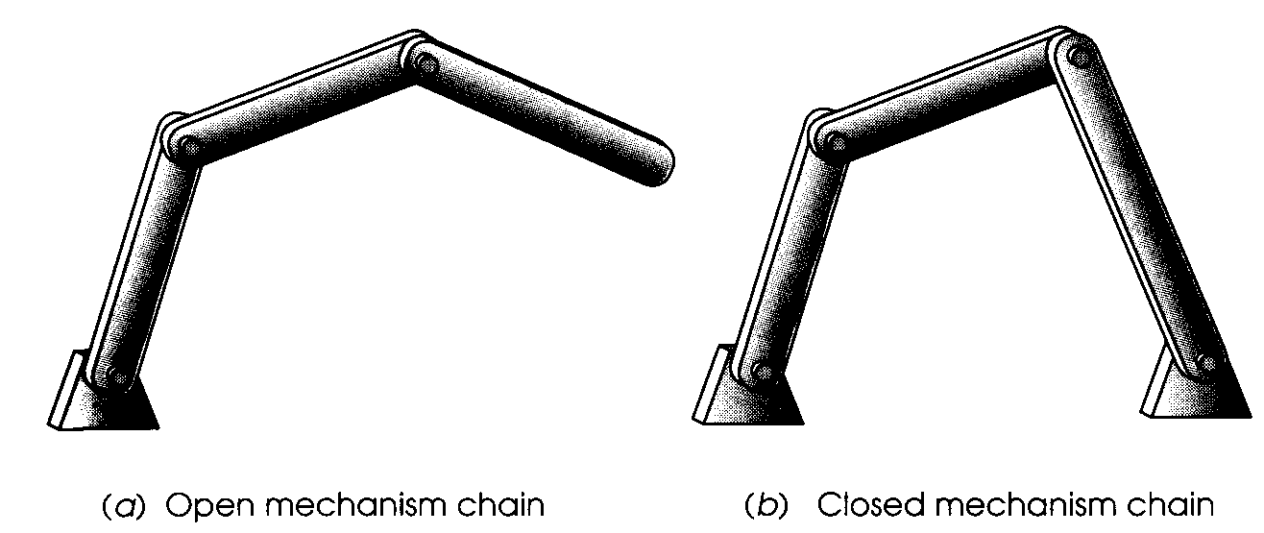
Open & Closed Mechanisms
Kinematic chains or mechanisms may be either open or closed.

Slide 5
Open & Closed Mechanisms (contd.)
A closed mechanism will have no open attachment points or nodes and may have one or more degrees of freedom.
An open mechanism of more than one link will always have more than one degree of freedom, thus requiring as many actuators (motors) as it has DOF. Ex- Industrial robot

Slide 6
Determining Degrees of Freedom
For simple mechanisms calculating DOF is simple
Closed Mechanism
DOF=1
Open Mechanism
DOF=3

Slide 7
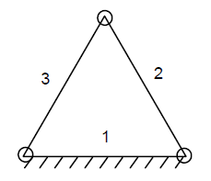
Four bar Mechanism
It may be observed that to form a simple closed chain we need at least three links with three kinematic pairs.
If any one of these three links is fixed (ground), there cannot be relative movement and, therefore, it does not form a mechanism but it becomes a structure which is completely rigid.

Slide 8
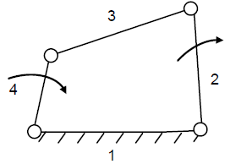
Four bar Mechanism (contd.)
Thus, a simplest mechanism consists of four links, each connected by a kinematic lower pair (revolute etc.), and it is known as four bar mechanism.
For example, reciprocating engine mechanism is a planner mechanism in which link 1 is fixed, link 2 rotates and link 4 reciprocates.

Slide 9
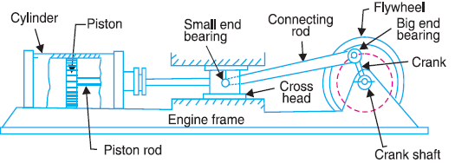
Reciprocating engine mechanism
The expansion of burning fuel in the cylinders periodically pushes the piston down, which, through the connecting rod, turns the crankshaft.
The continuing rotation of the crankshaft drives the piston back up, ready for the next cycle.
The piston moves in a reciprocating motion, which is converted into circular motion of the crankshaft, which ultimately propels the vehicle.

Slide 10
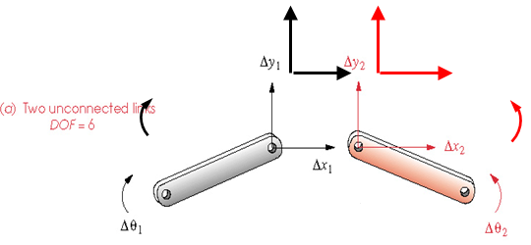
Degree of Freedom in Planar Mechanisms
Any link in a plane has 3 DOF. Therefore, a system of L unconnected links in the same plane will have 3L DOF, as shown in Figure, where the two unconnected links have a total of six DOF.

Slide 11
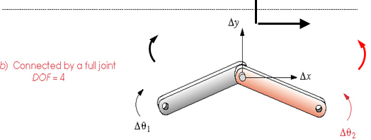
Degree of Freedom in Planar Mechanisms (contd.)
When these links are connected by a full joint in as in Figure, ΔY₁ and ΔY₂ are combined as ΔY, and Δx₁ and Δx₂ are combined as Δx. This removes two DOF, leaving four DOF.

Slide 12
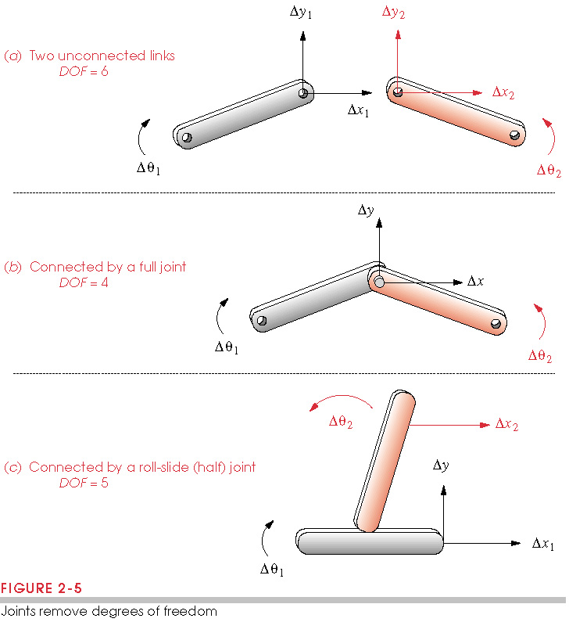
Degree of Freedom in Planar Mechanisms
Two unconnected links: 6 DOF
(each link has 3 DOF)
When connected by a full joint: 4 DOF
(each full joint eliminates 2 DOF)

Slide 13
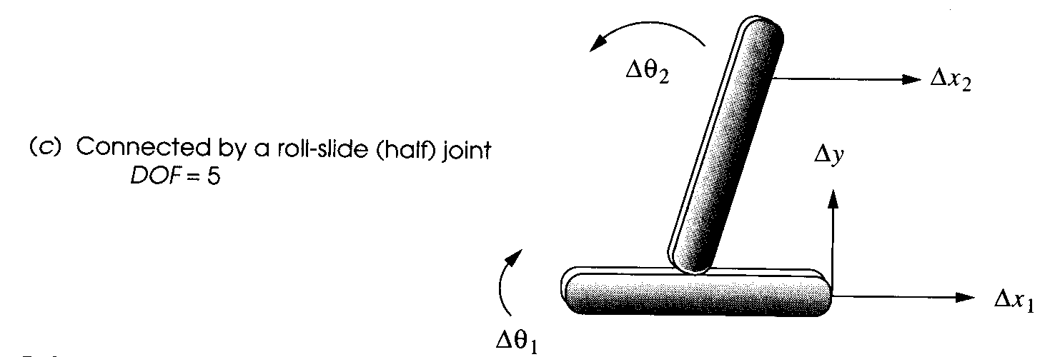
Degree of Freedom in Planar Mechanisms (contd.)
In Figure the half joint removes only one DOF from the system (because a half joint has two DOF), leaving the system of two links connected by a half joint with a total of five DOF.

Slide 14
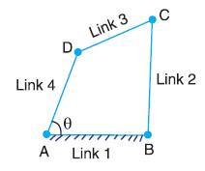
Another example
Consider a four bar chain, as shown in figure. A little consideration will show that only one variable such as Ө is needed to define the relative positions of all the links.
In other words, we say that the number of degrees of freedom of a four bar chain is one.

Slide 15
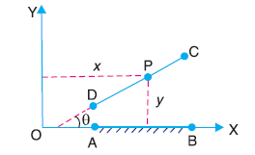
Another example (contd.)
Consider two links AB and CD in a plane motion as shown in Figure.
The link AB with coordinate system OXY is taken as the reference link (or fixed link).
The position of point P on the moving link CD can be completely specified by the three variables. i.e. the coordinates of P denoted by x and y, and inclination θ of link CD w.r.t. x-axis or link AB.

Slide 16
Another example (contd.)
In other words, we can say that each link of a mechanism has three degrees of freedom before it is connected to any other link.
But when the link CD is connected to the link A B by a turning pair at A, the position of link CD is now determined by a single variable θ and thus has one degree of freedom.
We have seen that when a link is connected to a fixed link by a turning pair (i.e. lower pair), two degrees of freedom are destroyed.

Slide 17
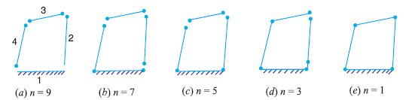
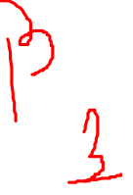
Another example (contd.)
We have seen that when a link is connected to a fixed link by a turning pair (i.e. lower pair), two degrees of freedom are destroyed.
This may be clearly understood from Figure given below, in which the resulting four bar mechanism has one degree of freedom.

Slide 18
Determining DoF’s
Now let us consider a plane mechanism with I number of links.
Since in a mechanism, one of the links is to be fixed, therefore the number of movable links will be (I - 1) and thus the total number of degrees of freedom will be 3 (I - 1) before they are connected to any other link.

Slide 19
Determining DoF’s
In general, a mechanism with l number of links connected by j number of binary joints or lower pairs (i.e. single degree of freedom pairs) and h number of higher pairs (i.e. two degree of freedom pairs), then the number of degrees of freedom of a mechanism is given by
M = 3 (I - 1) - 2j – h
This equation is called Gruebler’s criterion for the movability of a mechanism having plane motion.
If there are no two degree of freedom pairs (i.e. higher pairs), then h = 0. Substituting h = 0 in equation, we have
M = 3 (I - 1) - 2j

Slide 20
Gruebler’s equation for planar mechanisms
M = 3 (I - 1) - 2j
Note that the value of j must reflect the value of all joints in the mechanism; i.e. half joints count as 0.5 b/c they only remove 1 DOF. A modified form of Gruebler’s equation for clarity is known as Kutzbach’s modification, which take into account full and half joints separately;
M = 3 (L – 1) - 2J₁- J₂
Where
J₁= Number of 1 DOF (full) joints
J₂= Number of 2 DOF (half) joints

Slide 21
Important Note !!
It should be noted that Gruebler’s/Kutzbach’s equation has no information in it about link sizes or shapes, only their quantity.

Slide 22
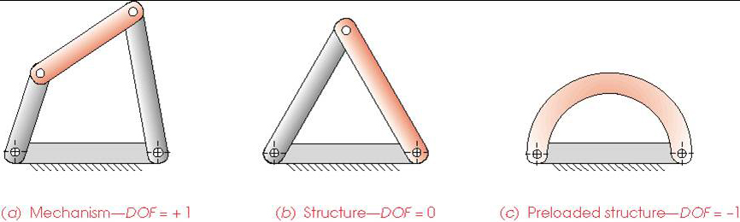
Mechanisms and Structures
If DoF > 0, it’s a mechanism
If DoF = 0, it’s a structure
If DoF < 0. it’s a preloaded structure (will have
built in stresses with manufacturing error)
Delta Triplet (Truss)

Slide 23
Preloaded Structure
Preloaded Structure – DOF<0, may require force to assemble
In order to insert the two pins without straining the links, the center distances of the holes in both links must be exactly the same, which is practically impossible, therefore require force to assemble causing stress in links

Slide 24
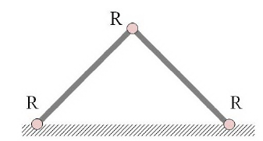
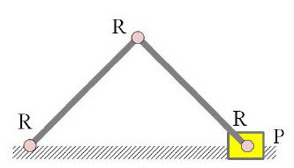
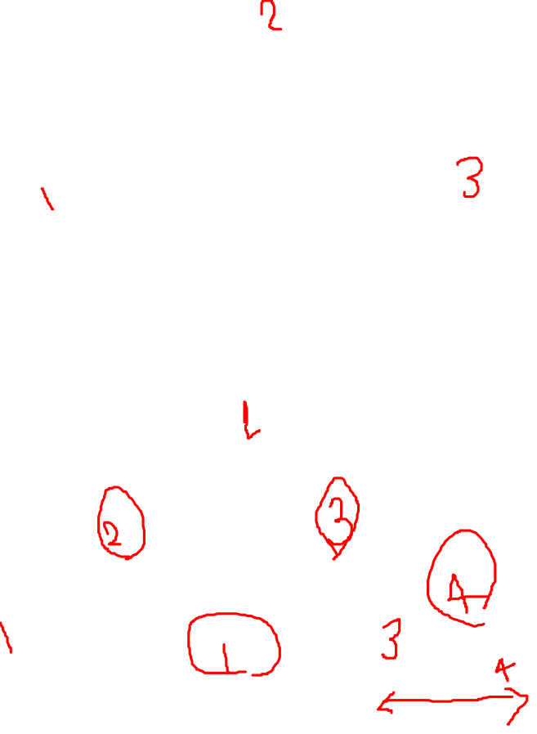
Calculate mobility of various configurations of connected links
Kutzbach’s criterion of mobility
M = 3 (L – 1) - 2J₁- J₂
L = 3, J₁= 3, j₂=0 ➔ M= 0; implying that this system of links is not a mechanism, but a structure.
L = 4, J₁= 4, j₂=0 ➔ M= 1; implying system of interconnected links in has mobility 1, which means that any link can be used as input link (driver) in this mechanism.

Slide 25
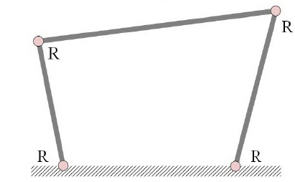
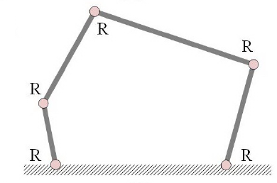
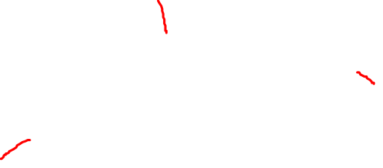
Calculate mobility of various configurations of connected links
L = 4, J₁= 4, j₂=0 ➔ M= 1; implying system of interconnected links in has mobility 1, which means that any link can be used as input link (driver) in this mechanism.
L = 5, J₁= 5, j₂=0 ➔ M= 2; implying system of interconnected links in has mobility 2, which means that any two links can be used as input links (drivers) in this mechanism.

Slide 26
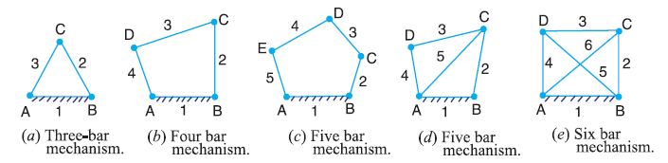
Example: 1
Determine the degrees of freedom or movability of mechanisms having no higher pair (i.e. h = 0)

Slide 27
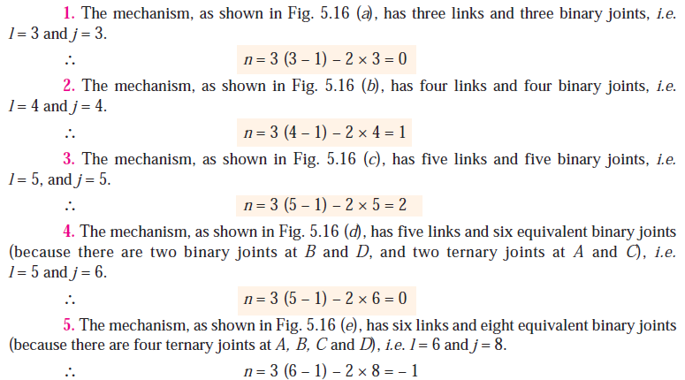
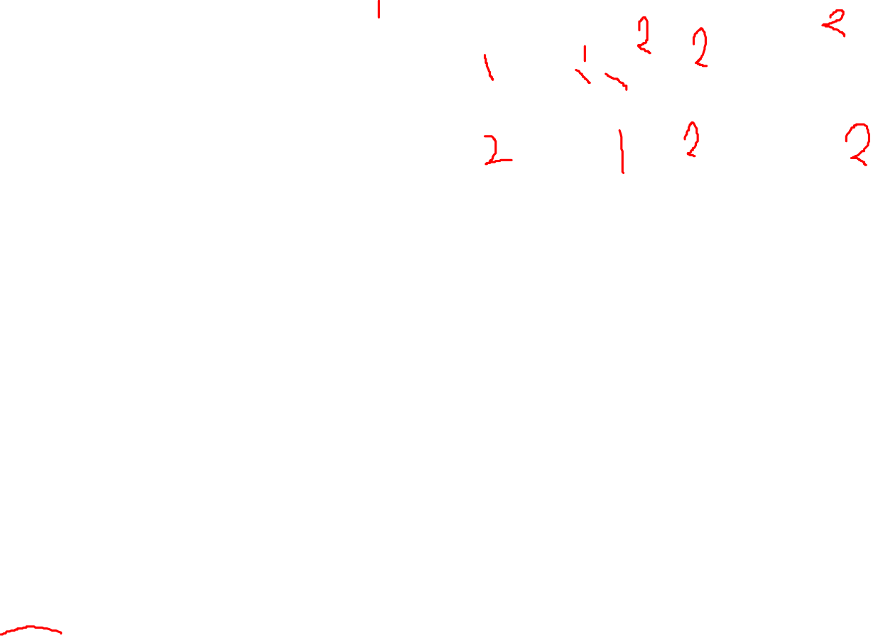

Slide 28
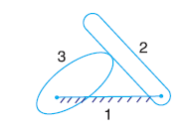
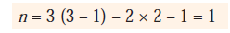
Mechanisms with higher pair

Slide 29
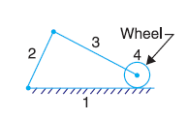
Mechanisms with higher pair (contd.)
Here it has been assumed that the slipping is possible between the links (i.e. between the wheel and the fixed link).
However if the friction at the contact is high enough to prevent slipping, the joint will be counted as one degree of freedom pair, because only one relative motion will be possible between the links.
Ex- driving car on dry & Icy road.

Slide 30
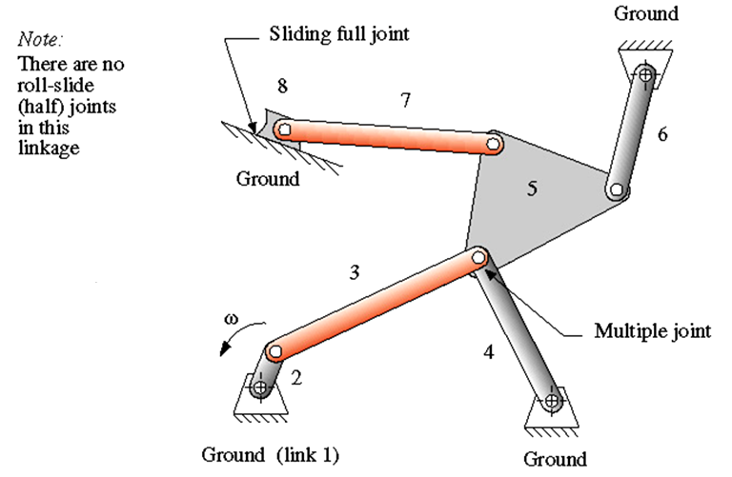
Example: 2
L= number of links = 8; J= number f full joints = 10 ➔ DOF = 1
Note: Multiple joints count as one less than the number of links joined at that joint and add to the "full" (J₁) category

Slide 31
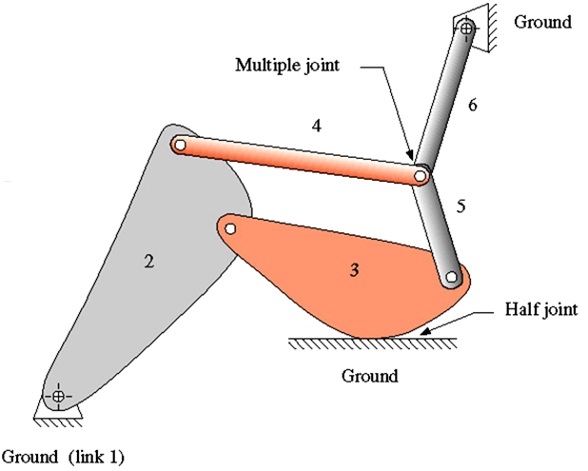
Example: 3
L= number of links = 6
J= number f full joints = 7.5 ➔ DOF = 0

Slide 32
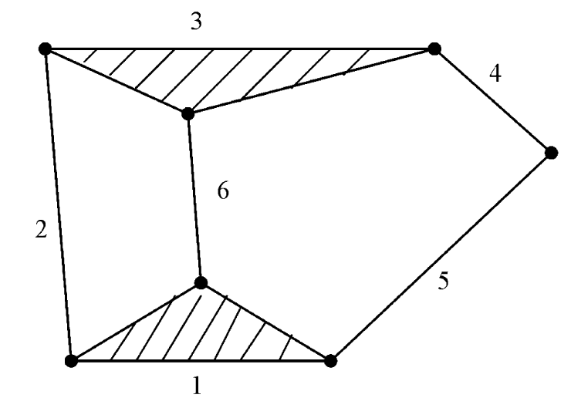
Exercise: 1
Determine the degrees of freedom of a six bar linkage.

Slide 33
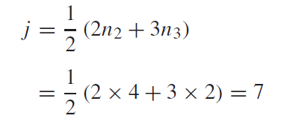
Exercise: 1 (contd.)
There are four binary links and two ternary links (i.e. link 1 & 3). The number of joints are (you can count them directly or use the following formula)
According to Gruebler/Kutzbach equation
M = 3 (6 – 1) – 2 x 7 = 1

Slide 34
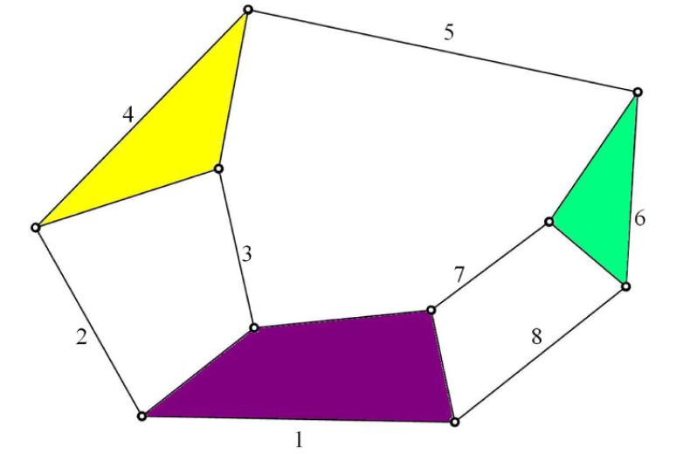
Exercise: 2
Determine the degrees of freedom of a eight bar linkage.

Slide 35
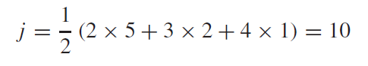
Exercise: 2 (contd.)
There are five binary links (n₂ = 5), two ternary links (n₃ = 2) and one quaternary link (n₄ = 1). Thus, number of joints are
According to Gruebler/Kutzbach equation
M = 3 (8 – 1) – 2 x 10 = 1
Thus, this linkage has also one degree of freedom.

Slide 36
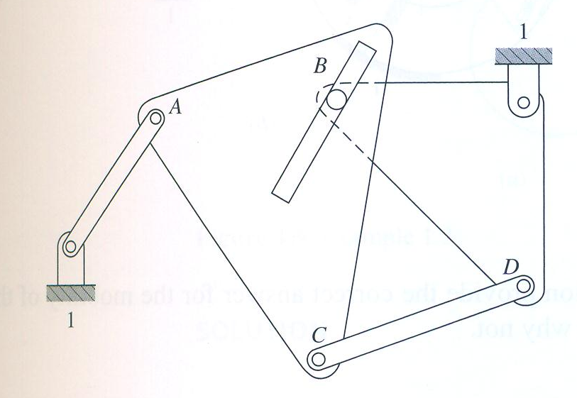
Exercise: 3
Determine the d.o.f or mobility of the planar mechanism illustrated below

Slide 37
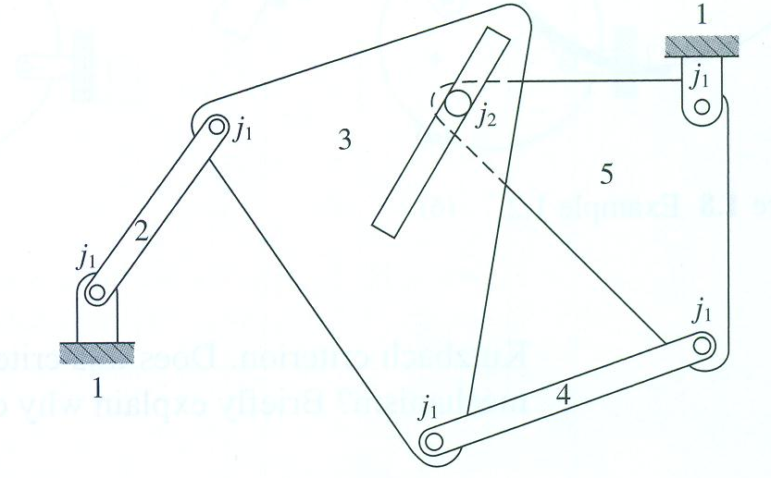
The link numbers and the joint types for the mechanism are illustrated above. The number of links is n = 5, the number of lower pairs is j₁ = 5, and the number of higher pairs is h or j₂ = 1. Substituting these values into the Kutzbach criterion, the mobility of the mechanism is
M = 3 (5 – 1) – 2 x 5 – 1 = 1
that is, a single input motion is required to gives unique output motion.

Slide 38
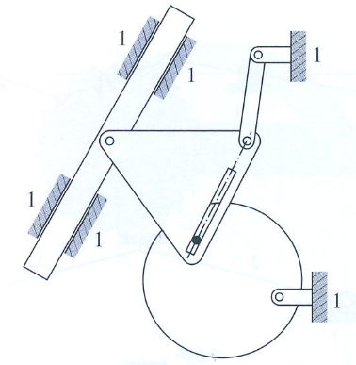
Exercise: 4
Determine the d.o.f or mobility of the planar mechanism illustrated below

Slide 39
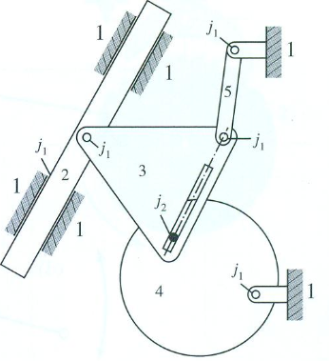
Exercise: 4 (contd.)
The number of links is n = 5, the number of lower pairs is j₁ = 5, and the number of higher pairs is h or j₂ = 1. Substituting these values into the Kutzbach criterion, the mobility of the mechanism is
M = 3 (5 – 1) – 2 x 5 – 1 = 1

Slide 40
Grubler's criterion for plane mechanisms
A little consideration will show that a plane mechanism with a movability of 1 and only single degree of freedom joints i.e. full joints can not have odd number of links. Substituting n = 1 and h = 0 in Kutzbach’s equation, we have
1 = 3 (l— 1) — 2 j or 3l— 2j— 4 = 0
This equation is known as the Grubler's criterion for plane mechanisms with constrained motion.
The simplest possible mechanisms of this type are a four bar mechanism and a slider-crank mechanism in which 1= 4 and j= 4.

Slide 41
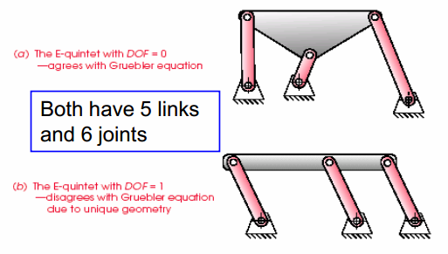
Degree of Freedom Paradoxes
Gruebler’s equation does not account for link geometry, in rare instance it can lead to misleading result

Slide 42
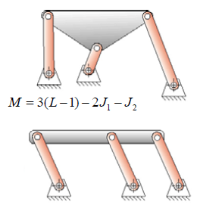
Degree of Freedom Paradoxes (contd.)
The “E-quintet” is an example in which If three binary links happen to have equal length, the joints of a middle link do not constrain the mechanism any more than the
outer links. The equation predicts DOF = 0, but the mechanism has DOF = 1.

Slide 43
Link Classification
Ground or fixed Link: fixed w.r.t. reference frame
Input [Driving] Link : Link where by motion and force are imparted to a mechanism
Output [Driven] Link : Link from which required motion and forces are obtained

Slide 44
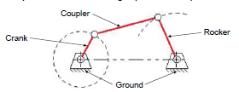
Link Classification

Slide 45
Link Classification (contd.)
Crank Link: pivoted to ground, makes complete revolutions; i.e. Link that rotates completely about a fixed axis
Rocker Link: pivoted to ground, has oscillatory (back & forth) motion
Coupler Link: aka connecting rod, is not directly connected to the fixed link or frame, it in effect connects inputs & outputs

Slide 46
Four Bar Mechanism
Four bar mechanism consists of four rigid links connected in a loop by four one degree of freedom joints.
A joint may be either a revolute, that is a hinged joint, denoted by R, or a prismatic, as sliding joint, denoted by P.

Slide 47
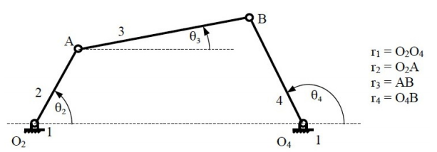
Four Bar Mechanism (contd.)
A link that makes complete revolution is called crank (r₂), the link opposite to the fixed link is the coupler (r₃) and forth link (r₄) is a rocker if oscillates or another crank if rotates.

Slide 48
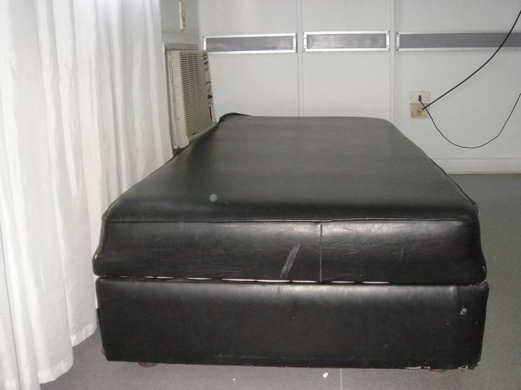
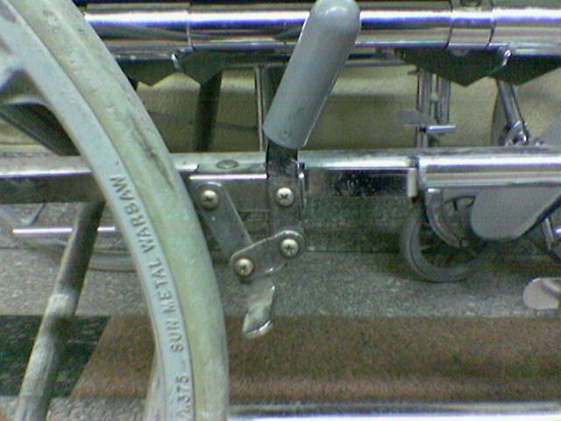
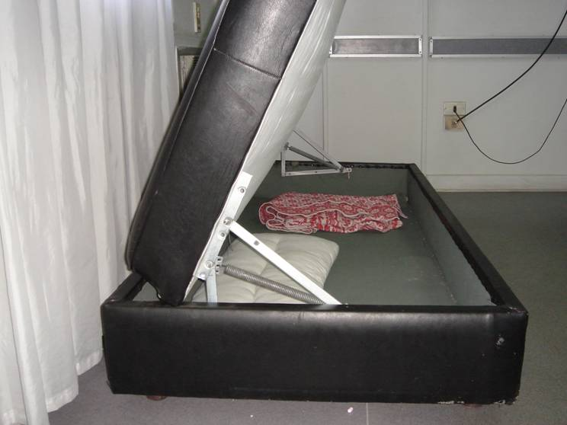
Four Bar Mechanism (contd.)
Brake of a Wheelchair
Folding sofa

Slide 49
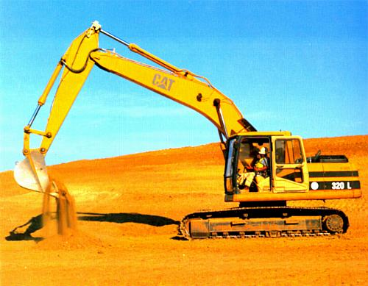
Four Bar Mechanism (contd.)
Backhoe Excavator

Slide 50
Mechanism Classification
Crank-rocker mechanism: In a four bar linkage, if the shorter side link revolves and the other one rocks (i.e., oscillates), it is called a crank-rocker mechanism.
Double-crank mechanism: In a four bar linkage, if both of the side links revolve, it is called a double-crank mechanism.
Double-rocker mechanism: In a four bar linkage, if both of the side links rock, it is called a double-rocker mechanism.

Slide 51
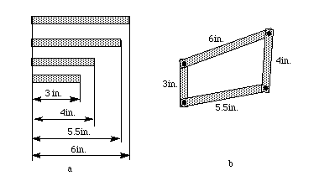
Do-it-yourself four bar linkage mechanism
Let's make a simple mechanism with similar behavior to that of wiper mechanism.
Take some cardboard and make four strips as shown in Figure a.
Take 4 pins and assemble them as shown in Figure b.

Slide 52
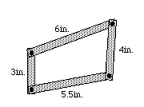
Do-it-yourself four bar linkage mechanism (contd.)
Now, hold the 6in. strip (i.e. fixed link) so it can't move and turn the 3in. Strip (i.e. input-crank link) . You will see that the 4in. strip (output – rocker link) oscillates.

Slide 53
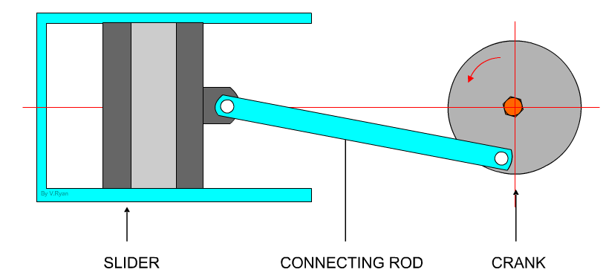
Examples: Slider-crank Mechanism
This mechanism is composed of three important parts:
The crank which is the rotating disc, the slider which slides inside the tube and the connecting rod which joins the parts together.

Slide 54
Slider-crank Mechanism (contd.)
As the slider moves to the right the connecting rod pushes the wheel round for the first 180 degrees of wheel rotation.
When the slider begins to move back into the tube, the connecting rod pulls the wheel round to complete the rotation.
Animation : http://www.technologystudent.com/cams/crkslid1.htm

Slide 55
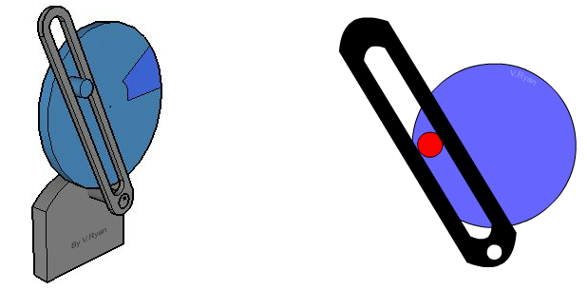
Quick Return Mechanism
A quick return mechanism such as the one seen below is used where there is a need to convert rotary motion into reciprocating motion.
As the disc rotates the black slide moves forwards and backwards. Many machines have this type of mechanism , such as shaping machine.
http://www.technologystudent.com/cams/crank1.htm

Slide 56
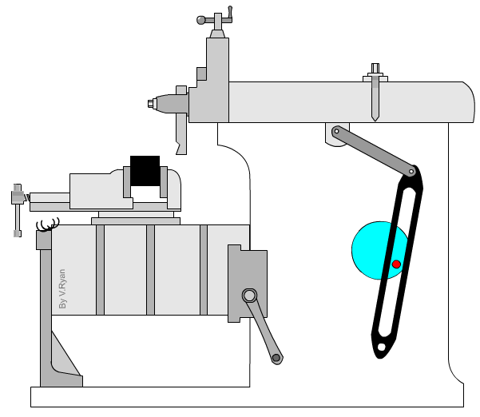
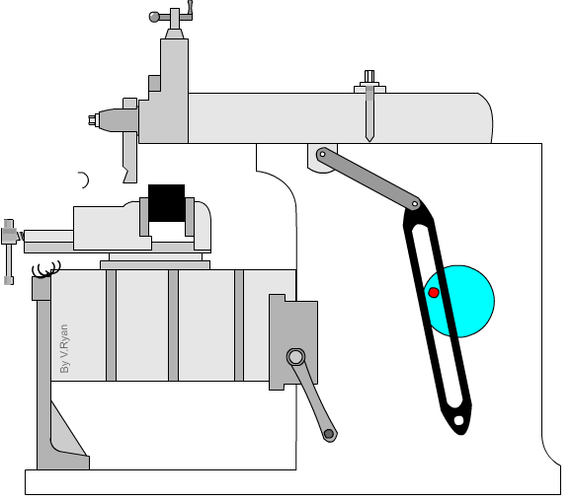
Example: Shaping Machine
As the disc rotates the top of the machine moves forwards and backwards, pushing a cutting tool.
Animation: http://www.technologystudent.com/cams/crank2.htm

Slide 57

Example: crank, connecting rod and piston mechanism

Slide 58
Example: crank, connecting rod and piston mechanism (contd.)
If the crank is turned, angular motion is converted into linear motion of the piston and input torque is transformed into force on the piston.
If the piston is forced to move, the linear motion is converted into rotary motion and the force into torque.
Thus, the crank and connecting rod are connected via a revolute joint, whereas connecting rod and piston are connected via a prismatic joint.

Slide 59
Kinematic Inversion
The process of choosing different links of a kinematic chain as the fixed or ground link, for generating new mechanisms is called Kinematic Inversion

Slide 60
Kinematic Inversion (contd.)
Thus there are as many inversions of a given linkage as it has links.
It should be noted that, the relative motion b/w various links are not altered, but their absolute motions (those measured w.r.t. fixed link) may change dramatically.

Slide 61

Inversions of slider-crank linkage
Figure shows the four inversions of the fourbar slider-crank linkage, all of which have distinct motions.

Slide 62

Animation
The four links - crank (in green), coupler (in red), slider (in blue), and track (in black) - are successively fixed (shown with an anchor) in each of the inversion.

Slide 63

Animation
The four links - crank (in green), coupler (in red), slider (in blue), and track (in black) - are successively fixed (shown with an anchor) in each of the inversion.

Slide 64

Inversion # 1
Inversion #1, with link 1 as ground and its slider block in pure translation, is the most commonly seen and is used for producing rotary motion of the wheels, crank etc.

Slide 65

Inversion # 2
Inversion #2 is obtained by grounding link 2 and gives the Whitworth or crank-shaper quick-return mechanism, in which the slider block has complex motion.

Slide 66

Inversion # 3
Inversion #3 is obtained by grounding link 3 and gives the slider block pure rotation.

Slide 67

Inversion # 4
Inversion #4 is obtained by grounding the slider link 4 and is used in hand operated, well pump mechanisms, in which the handle is link 2 (extended) and link 1 passes down the well pipe to mount a piston on its bottom. (It is upside down in the figure.)

Slide 68

Grashof’s Law
The Grashof Condition is a relationship that predicts the rotation behavior of the inversions of a fourbar linkage based only on the lengths of the links:
S = length of shortest link
L = length of longest link
P = length of one remaining link
Q = length of other remaining link

Slide 69
Grashof’s Law (contd.)
If S+L ≤ P+Q the linkage is Grashof :at least one link is capable of making a complete revolution
Otherwise the linkage is non-Grashof : no link is capable of making a complete revolution

Slide 70
Do you Remember !!!
Now, hold the 6in. strip (i.e. fixed link) so it can't move and turn the 3in. Strip (i.e. input-crank link) . You will see that the 4in. strip (output – rocker link) oscillates.

Slide 71
Grashof’s Law (contd.)
It should be noted that nothing in Grashof's law specifies the order in which the links are to be connected or which link of the four-bar chain is fixed.
That is, the determination of the Grashof’s condition can be made on a set of unassembled links.
Whether they are later assembled into a kinematic chain in S, L, P, Q, or S, P, L, Q or any other order, will not change the Grashof’s condition.

Slide 72
Grashof’s Law (contd.)
We are free, therefore to fix or ground any of the four links.
When we do so, we create the four inversions of the four linkage illustrated in next slide.
The motions possible from a fourbar linkage will depend on both the Grashof condition and the inversion chosen. The inversions will be defined with respect to the shortest link.

Slide 73

For S+L<P+Q
Crank-rocker if either link adjacent to shortest is grounded
Double crank if shortest link is grounded
Double rocker if link opposite to shortest is grounded

Slide 74


Slide 75
Grashof’s Law (contd.)
All of these (inversions shown on previous slide) fit Grashof's law, and in each the link s makes complete revolution relative to the other links.
The different inversions are distinguished by the location of the link s relative to the fixed link.

Slide 76
If we pay attention !!
There are as many inversions as links, but not all inversions will have distinct motions.
For example, a Grashof Fourbar has only 3 distinct inversions, 2 crank-rockers, 1 double-crank, and 1 double-rocker as shown in earlier slide.

Slide 77

For S+L > P+Q
All inversions will be double rockers
No link can fully rotate

Slide 78

Example: 1
Determine whether the four-bar linkage illustrated below is a crank-rocker four-bar linkage, a double-rocker four-bar linkage or double-crank four-bar linkage.

Slide 79

Example: 1 (contd.)
Substituting the link lengths into Grashof’s Eq: gives
Therefore, the given four-bar linkage satisfies Grashof’s law; that is, the linkage is a Grashof four-bar linkage.
Because the shortest link of the four-bar linkage is grounded, the two links adjacent to the shortest link can both rotate continuously (as shown earlier) and both are properly described as cranks.
Therefore, this four-bar linkage is a double-crank

Slide 80

Linkage transformation
The crank-slider (right) is a transformation of the fourbar crank rocker, by replacing the revolute joint at the rocker pivot by a prismatic joint, maintaining the same one degree of freedom. Note, slider block is actually Link 4.

Slide 81
Linkage transformation (contd.)
Replacing revolute joints in any loop by prismatic joints does not change the DOF, provided that at least two revolute joints remain in the loop

